Slide 1
Enterprise Solution (CST61)

Slide 2
UNIT-1
Introduction : ERP - Definition – Concept – Fundamentals – Need for ERP - Advantages of ERP –Implementation of ERP – Key issues and Characteristics of ERP Typical architecture components of ERP –ERP system Architecture. ERP and related technologies: Business Process RE-engineering – Management Information System– Decision Support System - Executive Support System – On-Line Analytical Processing, Supply Chain Management, Customer Relationship Management.

Slide 3
Define ERP.
Enterprise Resource Planning (ERP) is business management software.
It typically a suite of integrated applications that a company
can use to collect, store, manage and interpret data from
many business activities, including product planning, cost ,
Manufacturing or service delivery, Marketing and sales,
Inventory.

Slide 4
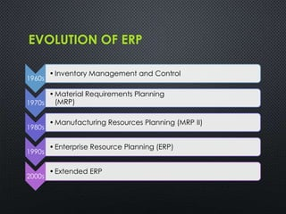

Slide 5
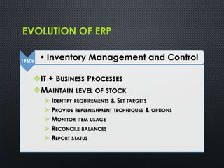

Slide 6
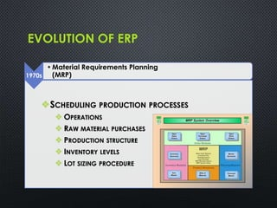

Slide 7
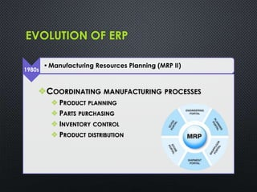

Slide 8
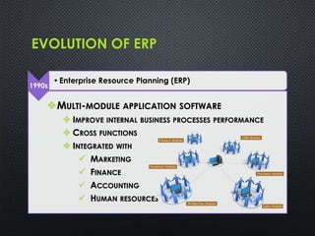

Slide 9
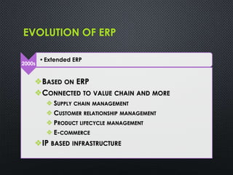

Slide 10
Fundamental Components of ERP
The following are the fundamental components of the ERP.
Financial Management
2. Business Intelligence
3. Supply Chain Management
4. Human Resource Management
5. Manufacturing Operations
6. Integration

Slide 11
Financial Management:
• At the core of ERP are the financial modules, including general ledger, accounts receivable, accounts payable, billing and fixed asset management.
• If organization is considering the move to an ERP system to support expansion into global markets,
make sure that multiple currencies and languages are supported, as well as regulatory compliance in
the U.S. and in foreign countries.

Slide 12
Other functionality in the financial management modules will include budgets, cash-flow, expense and tax reporting.
The evaluation team should focus on areas that are most important to support the strategic plans for
your organization.

Slide 13
Business Intelligence:
Business Intelligence (BI) has become a standard component of most ERP packages.
In general, BI tools allow users to share and analyze the data collected across the enterprise and
centralized in the ERP database.
BI can come in the form of dashboards, automated
reporting and analysis tools used to monitor the
organization business performance.
• BI supports informed decision making by everyone,
from executives to line managers and
accountants.

Slide 14
BI can come in the form of dashboards, automated reporting and analysis tools used to monitor the organization business performance.
BI supports informed decision making by everyone, from
executives to line managers and accountants.

Slide 15
Supply Chain Management:
Supply Chain Management (SCM), sometimes referred to as logistics, improves the flow of materials through an organization by managing planning, scheduling, procurement, and fulfillment, to maximize customer satisfaction and profitability.
Sub modules in SCM often include production scheduling,
demand management, distribution management, inventory
management, warehouse management, and procurement and
order management.

Slide 16
Any company dealing with products, from manufacturers to distributors, needs to clearly define their SCM requirements to properly evaluate an ERP solution.
It easy for a vendor to focus on their applications strengths and not address the full needs of the company.

Slide 17
Human Resource Management:
Human resource management ERP modules should enhance the employee experience – from initial recruitment to time tracking.
A Sub module can include payroll, performance management, time tracking, benefits, compensation and workforce planning.
Self-service tools that allow managers and employees to
enter time and attendance, choose benefits and manage
PTO are available in many ERP solutions.

Slide 18
Manufacturing Operations
Manufacturing modules make manufacturing operations more efficient through product configuration, job costing and bill of materials management.
ERP manufacturing modules often include Capacity Requirements Planning, Materials Requirements Planning, forecasting, Master Production Scheduling, work-order management and
shop-floor control.

Slide 19
Integration
Key to the value of an ERP package is the integration between modules, so that all of the core business functions are connected.
Information should flow across the organization so that BI reports on organization-wide results.
ERP can be easier than you imagine – Microsoft Dynamics ERP
is cost effective and familiar to your users. If you are thinking
about upgrading your systems to a fully integrated ERP system,
give us a call.

